Slide 1

Looking Inside the Company for Sources of Competitive Advantage

Slide 2
Business Strategy and Innovation
Internal Analysis
Objectives
To distinguish among a firm’s resources, capabilities, core competencies, and firm activities
To develop an understanding how the firms resources can drive competitive advantage
To learn how to develop a SWOT analysis and how to apply a SWOT to the formulation of business strategies
Notes:
Welcome Back and Welcome to our Fourth TOPIC in the Business Strategy and Innovation Module. In our last topic we studied External Analysis as a important step in developing business strategy. In that topic we focused on several classic external analysis frameworks, including the PESTEL Analysis, the Porter Five Forces Model and the Structure-Conduct-Performance Continuum.
In this topic we are going to discuss INTERNAL ANALYSIS with a focus on the Resource-Based View of Competitive Advantage.
The purpose of the INTERNAL Analysis topic is to: 1) to explore frameworks typically used by strategists to analyze and assess internal capabilities; 2) to develop an understanding of how core competencies and their underlying strategic resources drive competitive advantage, and 3) how to develop a SWOT analysis useful in driving strategy formulation.
The videos include, Looking Inside the Company
for Sources of Competitive Advantage,
The Resource-Based View of Competitive Advantage,
VRIO Analysis, The Value Chain Framework and Benchmarking,
and The SWOT Framework, identifying
strengths, weaknesses, opportunities and threats.

Slide 3
Business Strategy and Innovation
Internal Analysis
Lessons
Looking Inside the Company for Sources of Competitive Advantage
The Resource-Based View of Competitive Advantage
VRIO Analysis
Value Chain Analysis and Benchmarking
The SWOT Framework
Notes:
The videos lessons include: Looking Inside the Company for Sources of Competitive Advantage; The Resource-Based View of Competitive Advantage; VRIO Analysis; The Value Chain Framework; Benchmarking; and The SWOT Framework – Identifying Opportunities, Threats, Strengths and Weaknesses. At the conclusion of this topic, the student should be able compete the Analysis component of the AFI Framework for developing Business Strategy.

Slide 4
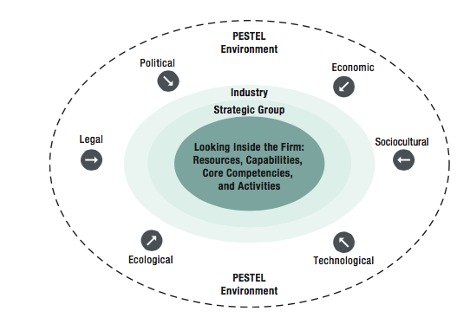
Internal Analysis
Source: Strategic Management Concepts and Cases by Frank K. Rothaermal
Notes:
The graphic shown here depicts a relationship
with a firm's external to internal environments
and the key components of each.
As discussed in the previous topic,
the external environment can be thought
of in terms of layers.
For the outermost layer, is the global world,
where macro forces can direct the impact
entire industries as well as firms.
As we move inward, industry structure becomes imported.
The competitor rivalry, buyer and supplier power,
it can pause a competition.
The inner most layer of the external environment
deals with the firms most direct competition.
Members of the firms strategic route.
For many industries, the external environment
is dynamic and ever changing, and determines
the strategy presents opportunities
and threats to firm performance.
The formulated and implemented strategy that enhances
firm performance, a firm must possess internal
capabilities that leverage opportunities
and protect against threats.
These capabilities are part of the firm's business model.
The business model itself, being the result of all
the previous strategic decisions and strategic
trade offs, made by the firm.

Slide 5
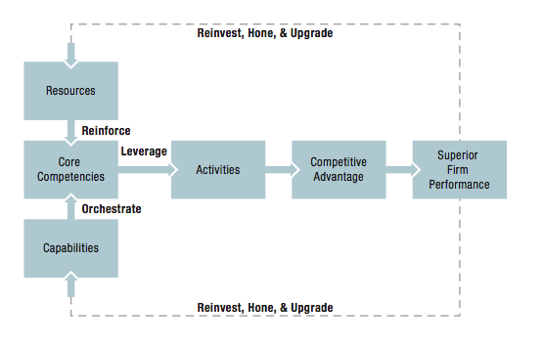
Internal Analysis
Core Competencies – unique strengths that drive competitive advantage
Resources – tangible and intangible assets of the firm
Capabilities – organizational and managerial skills
Activities – transform inputs into outputs
Source: Strategic Management Concepts and Cases by Frank K. Rothaermal

Slide 6
Why is Internal Analysis Important?
  Industry environments increasingly tumultuous.
  Changes in the firms external environment can alter the effectiveness of the firms competitive advantage
  Internal strengths change with the external environment. Strategic Fit is critical
  Key analytical tools
  VRIO
  Value Chain Analysis
  Benchmarking
Notes:
Internal Analysis is where the strategists focus on identifying and assessing organizational strengths in capabilities and resources critical to delivering the firm’s competitive advantage.. As noted in an earlier lesson, the firm effects of strategy and business model capabilities are more important in determining firm performance than industry structure. Its also important to note that external environmental changes however can shift the effectiveness of a firm’s competitive advantage, either diminishing it or enhancing competitive advantage. Competitive advantages are typically not sustainable if not kept relevant by investments and adjustments over time.
Managers have a number of tools and approaches that can guide the assessment of the firm’s capabilities and resources. A number of important ones are discussed in this lesson – including VRIO – which is a framework directed towards determining the strategic value of a resource;
value chain analysis, which focuses on the interaction of firm activities to create value (profits) for the company; and
benchmarking – a process that most managers are familiar with that’s directed towards identifying operational improvements and the implementation of best practices. However before we being our discussion of these internal analysis frameworks, its important to develop an understanding of the Resource-Based View of Competitive Advantage, the subject of our next lesson.
If you have any questions so far about Internal Analysis please leave your questions at the class forum.

Slide 7
The Resource- Based View
of Competitive Advantage

Slide 8
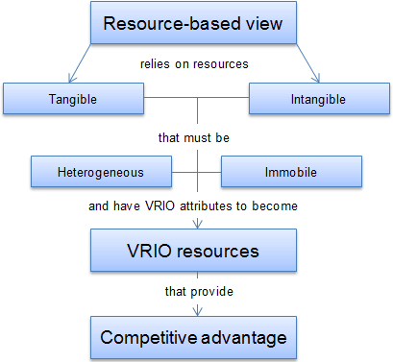
The Resource-Based View of Competitive Advantage
Tangible
  Easiest to identify
  Physical Assets (land, buildings, equipment)
  Financial Resources
  Need to understand their potential for creating competitive advantage
Intangible
  More likely (than tangible resources) to create a sustainable competitive advantage
  Difficult to measure -- especially on balance sheets)
  Large market-to-book valuation disparities
  One of the most important: Brands Technology / Intellectual Property
Human
  Skills, knowledge, know-how
  The most important resource for many firms is their human capital
  How different from intangible resources? Firms don’t own their employees
Notes:
The resource based view is a model that sees types of resources as key to superior firm performance.
The resource-based view is an approach
to achieve a competitive advantage.
According to the resource-based view proponents,
it is much more feasible to exploit
external opportunities using resources in a new way,
rather than trying to acquire new skills
for each new opportunity.

Slide 9

The Resource-Based View of Competitive Advantage
Notes:
The two critical assumptions of
the resource-based view are that resources
must also be heterogeneous and immobile.
If organizations would have the same amount
and mix of resources, they could not employ
different strategies to out-compete each other.
What one firm would do, the others would just simply follow,
and no competitive advantage could be achieved.
In fact, competitive parity would be pervasive.
This is the scenario of perfect competition.
Yet real world markets are far from perfectly competitive.
For a resource to be
at the basis of a competitive advantage,
it must be valuable, rare,
costly to imitate and organize to capture value.
The acronym VRIO.

Slide 10
Internal Analysis
VRIO Analysis

Slide 11
The Resource-Based View of Competitive Advantage
Notes:
In the resource based model certain types of resources are seen as key to superior firm performance. For a resource to be the basis of a competitive advantage, it must be valuable, rare, costly to imitate, and the firm must be organized to capture value. Jay Barney, on of the pioneers of the resource based view of the firm developed an assessment framework called VRIO Analysis. A firm can only gain and sustain competitive advantage if it has resources and capabilities that satisfy VRIO requirements. The framework is essentially a decision-tree based on four questions. Next we will discuss VRIO Analysis in detail.
ADVANCE POWERPOINT

Slide 12
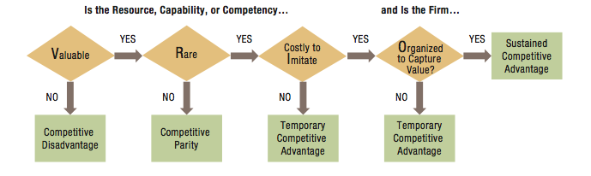
The VRIO Framework
Source: Strategic Management Concepts and Cases by Frank K. Rothaermal
If a firm’s resources are:
Valuable, rare, but not costly to imitate
Valuable, rare, and costly to imitate
and organized
to capture value
The firm can expect:
Temporary, competitive advantage
Sustained competitive advantage
Why Resources are Difficult to Imitate
Historical Conditions
Causal Ambiguity
Social Complexity
Notes:
One is historical condition.
Resources that were developed over
a long period are often costly to imitate.
Gran reputation is the best illustration of this condition.
Causal ambiguity.
In some cases, competitors may not be able
to identify the particular resource
or resources that are the cause
for the competitive advantage.
Think of this as a business version of the fog of war.
Cause of success or failure is not apparent.
The third condition is social complexity.
The resources and capabilities
are interwoven into the fabric of the firm's
culture and interpersonal relationships.
Two or more social and business systems interact
or combined, creating many and complex possibilities.

Slide 13
Internal Analysis
Value Chain Analysis and Benchmarking

Slide 14
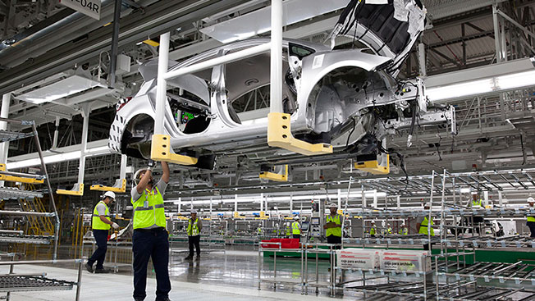



How Firms Create Value

Slide 15
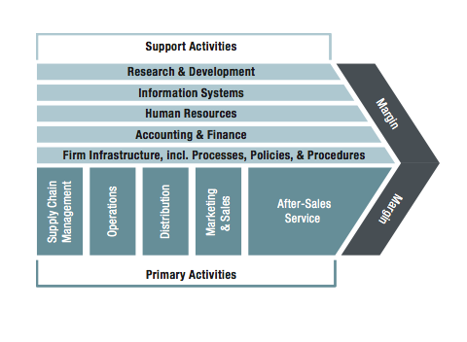
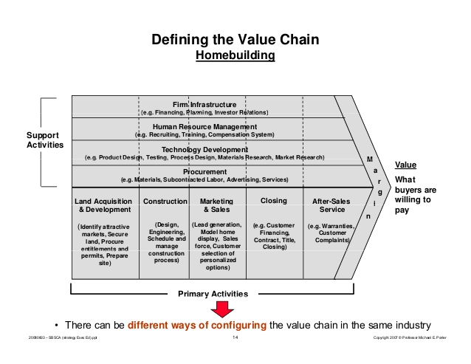
Value Chain Analysis
The Value Chain describes the internal activities a firm engages in when transforming inputs into outputs
Source: Strategic Management Concepts and Cases by Frank K. Rothaermal
Notes:
A value chain is the full range of activities a firm performs
to bring a product from conception to delivery.
Value chain analysis helps strategists understand how a firm creates value for
its customers.
This is a matter of fundamental importance, because it addresses
the economic logic of why the organization exists in the first place.
Understanding how the firm creates value and looking for more ways to add more
value are critical elements in developing a business strategy.
A value chain is the full range of activities a firm performs
to bring a product from conception to delivery.

Slide 16
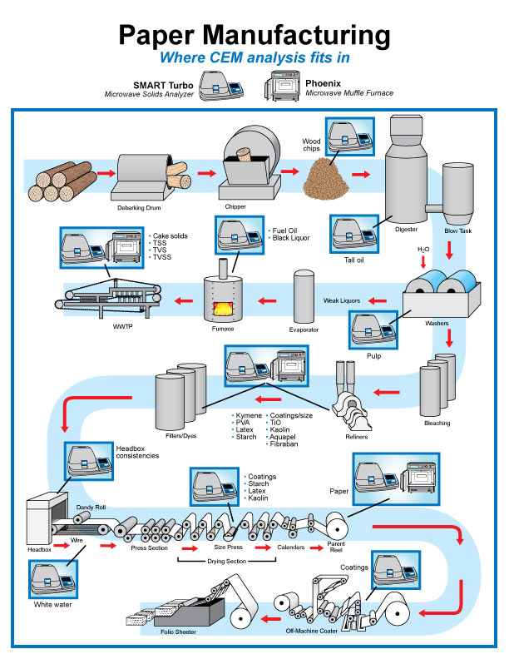
Process Benchmarking
Generic Paper Manufacturing
Process Schematic
Notes:
Process benchmarking compares specific processes or
activities to similar activities in different organizations.
Benchmarking may also include comparison to industry standards.
Typically beginning with a value chain analysis and/or
an analysis of key firm financial and operating performance ratios.
Process benchmarking focuses on those activities that will provide the most
significant impact on overall firm performance.
A few specific types of process benchmarking include the comparisons of
efficiency and effectiveness of production processes,
decision making processes, and business processes.
The production process comparison allows companies to review
individual processes related to producing goods.
The benchmarking of production processes can help firms compare their production
processes to another company and determine where significant differences exist.
This helps the manager better understand and gauge where the firm has strengths and
weaknesses in important capabilities.
Process benchmarking helps identify strengths and
weaknesses in current capabilities.
Benchmarking is also useful in identifying organizations that have superior metrics.
These organizations often become models for best practices.
Adopting best practices from other firms would generally not be enough
to create a competitive advantage.
More likely, the goal would be competitive parity.
That said, however, process improvements that drive down operating costs lead
to improved performance.

Slide 17
Internal Analysis
SWOT Analysis – Part 1

Slide 18
SWOT Analysis
Internal External
STRENGTHS
OPPORTUNITIES
+
_
WEAKNESSES
THREATS
Notes:
The SWOT Framework is so simple, that its hardly considered to be a framework by some strategists. Much like a “to do” list may not be considered to be a plan by some planners. But the fact remains that if properly done, a SWOT framework is a powerful and insightful way to summarized the results of external and internal analysis and to provide a basis to begin strategy formulation. Lets begin this discussion by constructing one.
A SWOT is essentially a 2 x 2 matrix form a set of quadrants. ADVANCE POWERPOINT.
Usually the y-axis of a SWOT represent a positive assessment at one end, and a negative assessment at the other. The X-axis is usually labeled internal at one end and external at the other. Internal and external can loosely be defined as under management control (internal) and outside management control (Internal). Internal and external also corresponds to the source of the analysis – either internal analysis or external analysis identified the factor. ADVANCE POWERPOINT.
The four quadrants are labeled strengths which are positive internals, weaknesses which are negative internals, opportunities which are positive externals, and threats which are negative externals.
ADVANCE POWERPOINT

Slide 19
Sample SWOT Analysis -- McDonalds
STRENGTHS
OPPORTUNITIES
Famous Brand
35000 Restaurant Locations
Strong Finances and Balance Sheet
High Profit Margins
Huge Advertising Budgets
Locally Adapted Food Menus in Other Countries
Growth in Emerging Economies
Menu Expansion with Healthier Options
Home Meal Delivery
All Day Breakfast Offerings
WEAKNESSES
THREATS
Lack of Healthy Food Choices
Perceived Low Food Quality
Poor Relationships with Franchisees
High Employee Turnover
Negative Publicity
Stiff Competition Across All Food Categories
Declining Market-Share
Saturated US Market
Increasing Health Consciences of Consumer
Minimum Wage Legislation
Currency Fluctuations

Slide 20
Internal Analysis
SWOT Analysis – Part 2

Slide 21
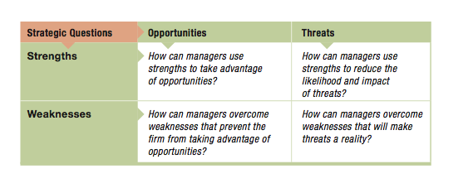
The SWOT Analysis
Source: Strategic Management Concepts and Cases by Frank K. Rothaermal
Notes:
The internal strengths and weaknesses, compared to the external opportunities and threats, can offer additional insight into the condition and potential of the business. How can you use the strengths to better take advantage of the opportunities ahead and minimize the harm that threats may introduce if they become a reality? How can weaknesses be minimized or eliminated? The true value of the SWOT analysis is in bringing this information together, to assess the most promising opportunities, and the most crucial issues. A modified SWOT framework, originally developed by Fred Davis in his text Strategic Management can help here.
Note that in this modified framework the SWOT contains an embedded 2 x 2 matrix with the following four quadrants.
Strengths – Opportunities (SO) are offensive alternatives by using internal strengths to exploit them. These opportunities are a good fit.
Weakness – Opportunities (WO) are situations where a weakness must be overcome to pursue an opportunity
Strengths – Threats (ST) are defensive alternatives that are ways that a firm can use its strengths to reduce the negative impact of a threat or to defend against a threat altogether
Weakness – Threats (WT) here the firm needs to establish a defensive plan to prevent a firm’s weaknesses from making the firm highly susceptible to external threats
ADVANCE POWERPOINT

